Slide 1
Decisions to be made before starting a partnership in Practice Enterprise
gabriella.paganelli3@unibo.it

Slide 2
The main objective of this presentation is the description analysis of process to be applied for the Practice Enterprise start-up

Slide 3
Within the workplan of PICASP Project are scheduled the following activities:
 |  | M1 | M2 | M3 | M4 | M5 | M6 | M7 | M8 | M9 | M10 | M11 | M12
1.2 | Meetings with local key institutions and enterprises for the definition of the professional profile and main skills. |  |  |  | 1X |  |  | 1X
1.3 | Training of the PC Universities staff. |  |  |  |  | 3X | 3X |  |  | 3X | 3X
1.4 | Building the basic framework of professional profiles and skills |  |  |  | 1X | 1X | 1X
1.5 | Improving the programme facilities infrastructures particularly as it concerns new didactics (Practice Enterprise Classrooms and Practice Management Laboratories). |  | 2X | 2X | 2X
2.1 | Building the structure of Pilot Courses |  |  |  |  | 1X | 1X | 1X |  | 1X
2.2 | Development of Curricula and Syllabi | 1= | 1X= | 1X= | 1X=
2.3 | Coordination and accreditation of Pilot Courses |  |  |  |  | 1X | 1X | 1X |  | 1X | 1X
2.4 | Testing the technical premises for new didactics |  |  |  |  |  |  | 1X= |  | 1X=
2.5 | Improving the skills on New Didactics of teachers, tutors and technical staff of pilot courses |  |  |  |  | 1X | 1X | 1X |  | 1X
2.6 | Enrolment of students, teachers,tutors,mentors and tech. Staff |  |  |  |  |  | 2X |  |  | 2X
2.7 | Realization of the courses/lectures (1st Cycle) |  |  |  |  |  |  |  |  | 4X | 4X | 4X | 4X
2.9 | Implementation of Interuniversity Network for new Didactics |  |  |  |  | 1= | 1X= |  |  | 1X= | 1X= | 1X= | 1X=
2.10 | Enforced networking with non consortium organizations |  |  |  |  | 1X= | 1X= | 1X= |  | 1X= | 1X= | 1X= | 1X=

Slide 4
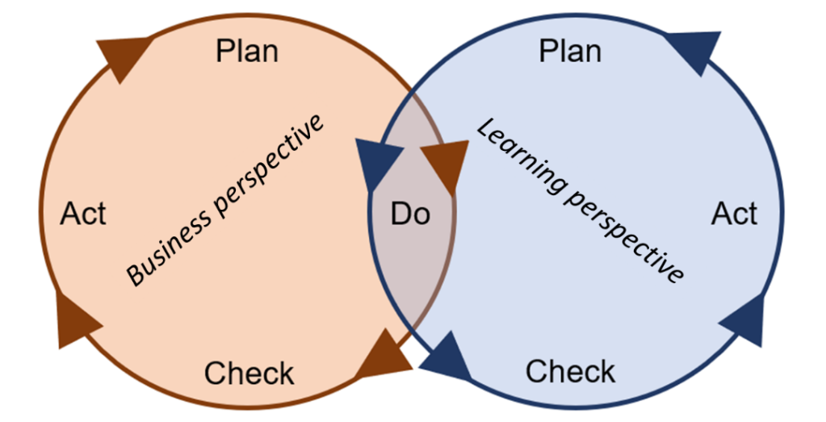
 |  | 2022 |  |  |  | 2023
 |  | Sept | Oct | Nov | Dec | Jan | Feb
2.7 | Realization of the courses/lectures (1st Cycle) | 4X | 4X | 4X | 4X |  | 4X

Slide 5
PE START UP KEY TOPICS
Mentor Companies or Mentors coming from them can provide a valuable source of information and the PE might be modelled in terms of products and services and marketing approach
Industry Key Figures might be used to develop an economically valid model
The formulation of a Business Plan provides the possibility to record essential aspects (e.g. products and services, competitors) and might also be used as document to introduce new students to the PE.

Slide 6
PE START UP Basic Process
Shareholders Assembly
Advisors ( Did. Staff)
C.E.O. Chief Executive Officer
Administrative Department
Commercial Department
Production Department

Slide 7
PE START UP Basic Process
Students Recruiting
D.Staff Presentation and Introduction
Didactical Staff Recruiting
Teacher
Tutors
Mentor
Commercial Dpt.
>> LOGO
>> Promotion
Jobs Assignment ( Org. Chart)
Administr. Dpt.
>> Program of Accounting
Draft Business Plan
Production. Dpt.
>> Technical Specifications

Slide 8
N° of Students | Tasks | Notes
2 | Market analysis (Competitors, Customers,Suppliers) and networking | Main objective : prepare the Business Plan Draft to discuss with all other Dpt.
2 | Preparation of the catalogue and promotional materials | After ended the preparation of material, support to networking
2 | Process of reception for orders, sale documents | Also support to networking
2 | Learning about the accounting software
2 | Staff Contracts Staff recruitment
2 | Collection and payment of orders. Use of internet banking
2 | Preparing the PE Web site
2 | Buying programs for suppliers
2 | Define technical specifications of products | Tot. Students 18
Commercial Dpt.
>> LOGO
>> Promotion
Administr. Dpt.
>> Program of Accounting
Production. Dpt.
>> Technical Specifications

Slide 9
Mentor is a person coming from the real economy and from the same economic sector in which the Practice Enterprise decides to run its business. His role is to provide business information and assistance to the students according to the real market. This may include information about numbers of staff, salaries, capital, their own organisation chart and copies of procedures manuals. He may help Practice Enterprises to set up the simulated best practices of business such as marketing strategies, how to elaborate a market pool, budgets and price lists. As such, the Mentor function as a link between the real market and the simulated educational environment.

Slide 10
CLUSTERING VS NETWORKING
 | Clustering | Networking
Personal preparation | From professional courses | Learning from the market feedback and organizing needed competencies
Financing | Collect as much financial resources as possible | Financing from Customers and Suppliers
Strategy | Push Approach | Pull Approach

Slide 11
Push and pull approaches to Enterprise creation.
Push | Pull
Professional training | The commitment
↓ | ↓
Financial supports and facilities | The achievement of entrepreneurial practice
↓ | ↓
The join of minimum size of economic production . | The building of strong ties with customers and suppliers

Slide 12
THE NETWORKING RESULTS OF PERTING – UNIBO P.E.

